Slide 1

Green Technology
Green Process
Created by Vivek, Pratik and Ashutosh

Slide 2

What is Green Process?
To reduce the carbon contents from the environment reengineering of business process takes place, such a process is termed as ‘Green Process.’
Such processes takes place or occur at three different levels namely:
Individual
Organizational
Collaborative
Lets see all of the above types in brief!

Slide 3

Individual Process
The efforts taken at individual level to reduce the carbon emission at the individual level is termed as the ‘Individual Process.’
Individual processes tend to be tactical and tend to provide quick wins, such as individuals switching off their computers, laptops when not in use.
Such efforts or tasks by every individual makes a huge impact on the environment and results in decrease in carbon level at significant level.
This Photo by Unknown Author is licensed under CC BY-SA-NC

Slide 4

Organization Process
We talk about an organization(be it any) we see a set of rules that is to be followed by every person related to the organization with any means. Organizations can play a crucial role in Green IT Revolution by implementing various rules and disciplines in interest to the environment.
Various policies can also be implemented to boost the green revolution and also to demonstrate the ROI on investment for green enterprise.
Organization level processes cover the individual processes.

Slide 5

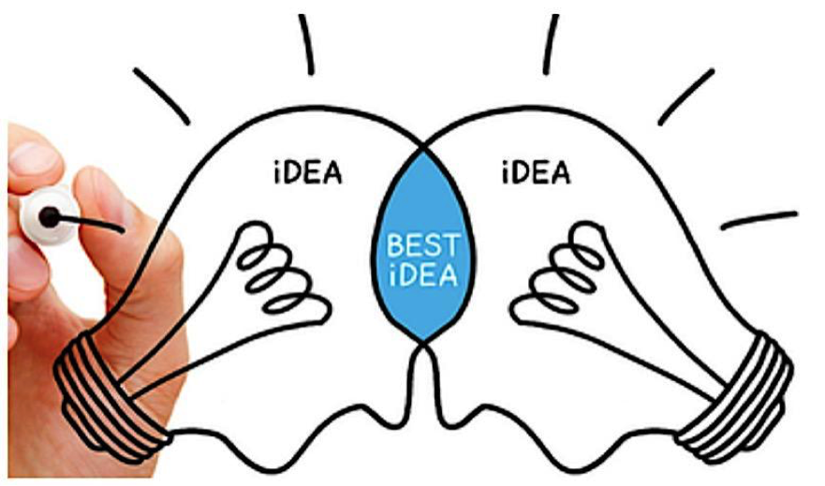
Collaborative Process
When we talk about collaboration we often talk about business organizations coming together on an investment or some programs that benefits both the organization/individuals with best suitable options.
Collaborative processes tend to deliver long term results/benefits. Collaborative processes requires more time and efforts and include more individual/organizations and multiple systems.
These processes can be very useful in scattering knowledge about green technologies and the regulations and other useful contents across regions.
Collaborative Processes are nothing but organization and individuals coming together and making efforts to spread awareness about Green IT and also making it happen in the near future.

Slide 6
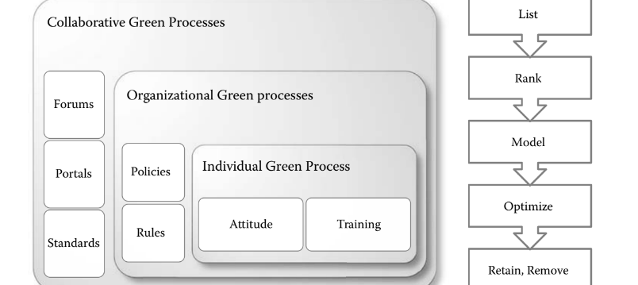
Green Processes: Individual, Organization, Collaborative.
The following image gives a proper explanation about the various green processes and their key factors.

Slide 7
Understanding various methods for evaluation of processes:
Now while executing the above processes careful evaluation of these levels needs to be undertaken.
During this evaluation, these processes are listed, ranked (prioritized), modeled, optimized, and eventually, either retained or eliminated. These steps, as applicable collectively to all processes in the organization. These steps, in terms of Green BPR, further described as follows:
◾ Listing—of all processes within an organization. This an initial list, which will be refined as this green transformation exercise proceeds. This list can be created based on the value creation of the organization and which can be categorized into primary, secondary, or supporting processes based on major functions of the organization such as production, inventory, supply chain , customer relations, finance, and HR. Each group of processes can again have levels, such as end-to-end processes, subprocesses, activities, and tasks. Each process within the list can have a description of what it provides or which goal of the organization is served by the process.

Slide 8

◾ Ranking—of the processes within the process list can be undertaken based on the carbon criteria. Thus, while normal BPM exercises list the processes with criteria such as their costs and effectiveness, in Green BPM, these processes are also ranked based on the amount of
estimated carbon they produce. While this estimation can be uncertain in the first instance, still as the organization proceeds with its Green BPM exercise, it can easily reevaluate its carbon estimates. This ranking is meant to provide an understanding of which particular processes should be given highest priority in terms of green reengineering.
◾ Modeling—process reengineering requires accurate modeling of those processes. If an organization has already undertaken a BPM exercise, process models for all major processes should be available. If not, the green transformation project can start by modeling the processes that are ranked high in the previous step. Process modeling in itself is a vast topic;
however, here it has been discussed within the narrow context of Green BPR. The (Unified Modeling Language) UML ( particularly its use cases and activity graphs), user stories, BPMN (business process modeling notation), and ( Integration Definition) IDEF are all well-known techniques for process modeling. Any of these techniques, or their combination,
can be used for modeling of processes.

Slide 9
◾ Optimizing—this step is the study of the processes that are modeled from their carbon impact. Thus, each activity within the process model can be studied and the carbon generated within that activity ascertained. Then, that activity can be modified to reduce its carbon, supported by technologies and systems to again reduce its carbon, or eliminated if found to be unnecessary. The optimization of processes is a substantial part of the Green BPM exercise and has to be taken in coordination with other dimensions of the organization.
◾ Retaining—processes that are modeled and optimized will reduce their carbon contribution. These are the processes that can be retained and placed in a continuously optimized mode. These processes will also be the core business processes of the organization that have to be maintained in the best possible way. Therefore, for processes that have to be retained, the rankings will be high and the optimization process will be iterated two to three times.
◾ Removing—the BPM exercise will also identify processes that are either redundant/duplicated or are so excessively carbon inefficient that they have to be replaced. These are the processes that will be removed from the suite of business processes. The impact of their removal has to be studied across all other dimensions before processes are removed. In practice, it is also discovered that some processes, typically manual processes, that were being undertaken without total awareness on the part of the rest of the organization, will get eliminated. The informal processes, however, are the most difficult to eliminate as they don’t have proper process models and supporting technologies.

Slide 10


